Slide 1




CyberSec Overview
ITP63

Slide 2

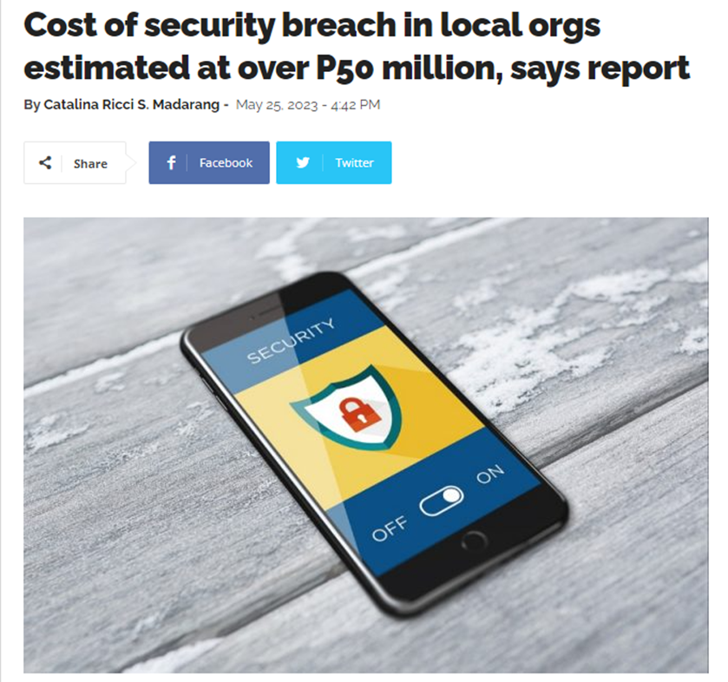
CyberSec
Cybersecurity is the practice of protecting systems, networks, and programs from digital attacks (cyberattacks) - Cisco

Slide 3
CyberSec
Objectives
Confidentiality ensures that unauthorized individuals are not able to gain access to sensitive information (ie develop and implement security controls, including firewalls, access control lists, and encryption, to prevent unauthorized access to information)
Integrity ensures that there are no unauthorized modifications to information or systems, either intentionally or unintentionally. Integrity controls, such as hashing and integrity monitoring solutions, seek to enforce this requirement.
Availability ensures that information and systems are ready to meet the needs of legitimate users at the time those users request them. Availability controls, such as fault tolerance, clustering, and backups, seek to ensure that legitimate users may gain access as needed.

Slide 4
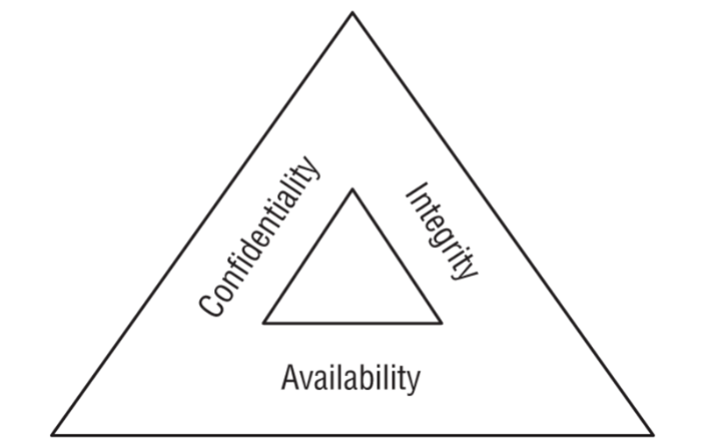
CyberSec
Objectives

Slide 5

Data
Breach Risks
Security incidents occur when an organization experiences a breach of the confidentiality, integrity, and/or availability of information or information systems.

Slide 6
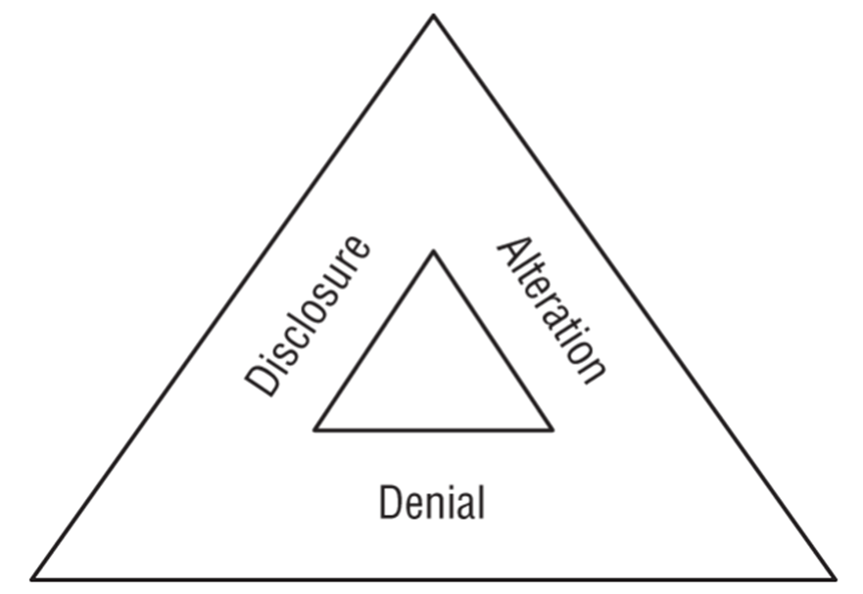
The DAD
Triad

Slide 7
The DAD
Triad
Disclosure is the exposure of sensitive information to unauthorized individuals, otherwise known as data loss. Disclosure is a violation of the principle of confidentiality.
Alteration is the unauthorized modification of information and is a violation of the principle of integrity
Denial is the unintended disruption of an authorized user's legitimate access to information. Denial events violate the principle of availability

Slide 8
Breach
Impact
FINANCIAL RISK
REPUTATIONAL RISK
STRATEGIC RISK
OPERATIONAL RISK
COMPLIANCE RISK
Financial risk is, as the name implies, the risk of monetary damage to the organization as the result of a data breach.
Reputational risk occurs when the negative publicity surrounding a security breach causes the loss of goodwill among customers, employees, suppliers, and other stakeholders.
Strategic risk is the risk that an organization will become less effective in meeting its major goals and objectives as a result of the breach.
Operational risk is risk to the organization's ability to carry out its day-to-day functions.
Compliance risk occurs when a security breach causes an organization to run afoul of legal or regulatory requirements.

Slide 9
Cybersecurity Threat Classifications:
•Internal vs. External
•Level of Sophistication/Capability
•Resources/Funding
•Intent/Motivation

Slide 10
Cybersecurity
Adversaries types
White-hat hackers, also known as authorized attackers, are those who act with authorization and seek to discover security vulnerabilities with the intent of correcting them.
Black-hat hackers, also known as unauthorized attackers, are those with malicious intent.
Gray-hat hackers, also known as semi-authorized attackers, are those who fall somewhere between white- and black-hat hackers.

Slide 11
Thank
You

